Slide 1
Functional Leadership
Functional leadership is model that concentrates on how leadership occurs, rather than focusing on who does the leading.
It defines the types of behaviors that guide an organization and then looks at how those behaviors occur. Under this model, leadership is a distributed function.
Notes:
Function is focus: what is done is more important than who does it.

Slide 2
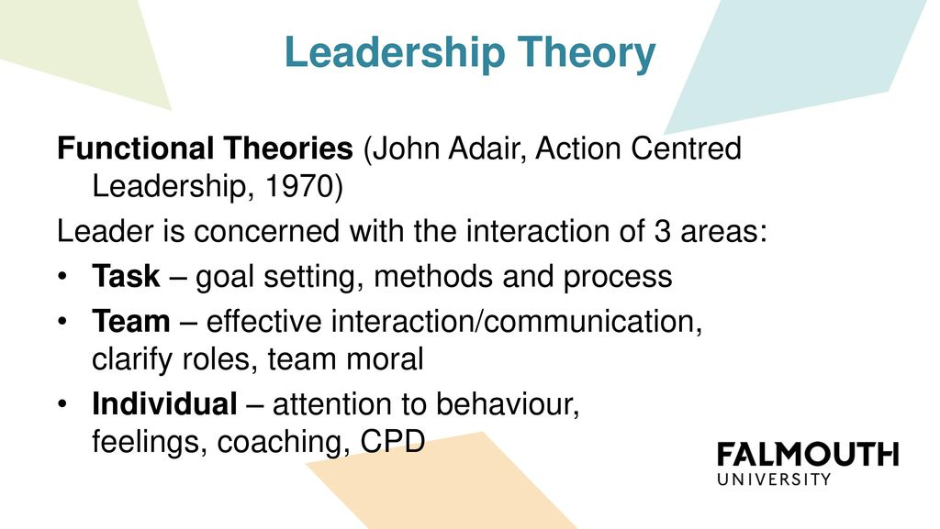
Functional Leadership Theory

Slide 3
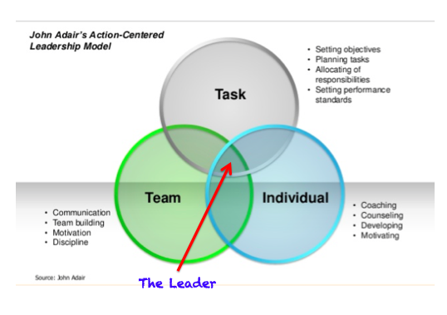
Functional Leadership Theory: Major Focus

Slide 4
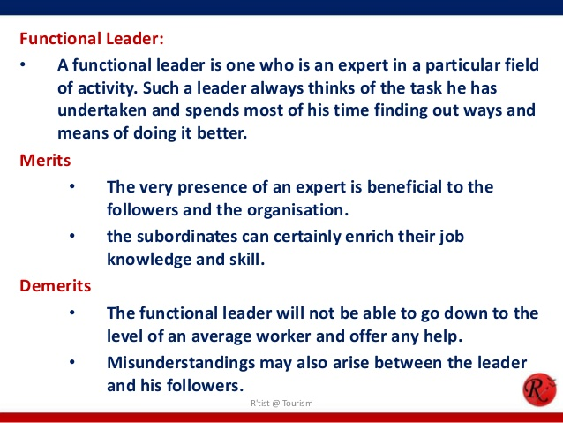
Functional Leadership Theory

Slide 5
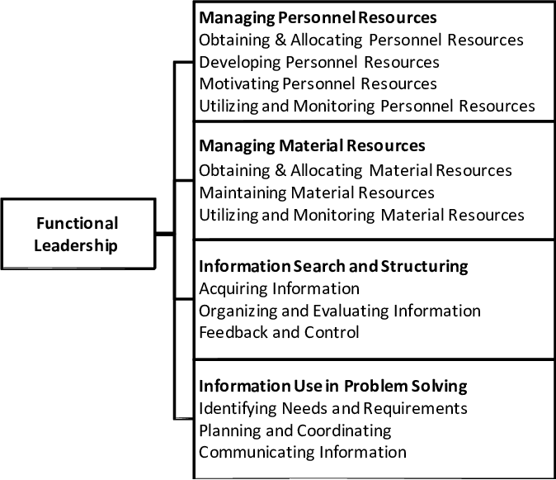
Functional Leadership: Focus on Functions

Slide 6
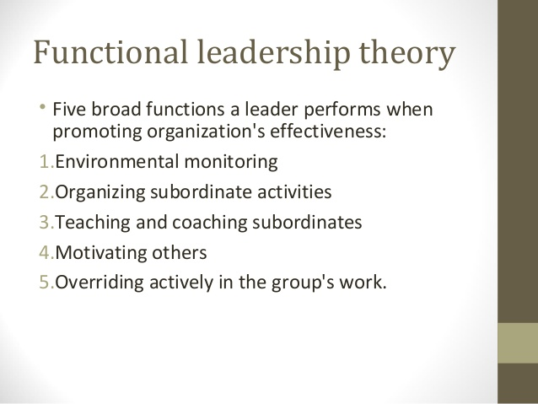

Slide 7
10 Functional Leadership Characteristics
According to the functional leadership model, the primary task of the leader is to ensure that all requirements of the group are met so that goals can be achieved.
The functional style places more importance on behaviors that get things done rather than assigning a formal leadership role.

Slide 8
10 Functional Leadership Characteristics Contd.
1. Priority on needs
The basic notion of functional leadership is that any group will have three primary needs:
The needs of the task
The needs of the team
The needs of individuals who make up the team
These three needs are the basic building blocks that form functional leadership. When these needs are met, goals are achieved and the organization progresses.

Slide 9
10 Functional Leadership Characteristics Contd.
2. Focus on actions
The functional leadership theory has been developed after studying the behaviors of successful leaders, and identifying the particular actions that led to successful results. Here, the focus is more on what the leader does than on who the leader is.

Slide 10
10 Functional Leadership Characteristics Contd.
3. Result oriented
In functional leadership, what matters is whether things get done. The leadership role is fluid and the primary emphasis is on ensuring behaviors that achieve a particular result. It isn’t much use getting applauded on a great leadership style if nobody does anything.

Slide 11
10 Functional Leadership Characteristics Contd.
4. Flexible leadership role
The functional leadership approach maintains that it is not necessary for a group to have only one particular member who performs all the leadership functions.
The idea is that any group member can perform these actions, which means that anyone can be the leader. It doesn’t matter who does what, what matters is whether the task gets done. Therefore, the leadership role itself is quite flexible.

Slide 12
10 Functional Leadership Characteristics Contd.
5. Clear understanding of individual responsibilities
Under the functional leadership style where the actions of each individual matter, it is of vital importance that each member knows exactly how he or she contributes to the group to achieve its goals. Everyone has to know what they’re supposed to do, and the leader is responsible to ensure clear understanding of each individual’s desired behaviors.

Slide 13
10 Functional Leadership Characteristics Contd.
6. Organizing
In order for the group to effectively perform their task, the functional leader must ensure that the group is properly organized. Not only should each member have a clear understanding of what is expected of them, but the group itself should be properly structured to facilitate their actions.

Slide 14
10 Functional Leadership Characteristics Contd.
7. Motivation
The functional leader must ensure that every individual in the group feels sufficiently appreciated for their efforts and actions. In the absence of motivation or clear communication about how their actions contribute to the group’s success, there’s a high chance that members might get dejected and leave the group.

Slide 15
10 Functional Leadership Characteristics Contd.
8. Controlling
Functional leadership involves a great deal of controlling exactly what happens in the team. Resources are usually limited in any situation, and the leader must control what happens by being efficient about getting the maximum results from the available resources.

Slide 16
10 Functional Leadership Characteristics Contd.
9. Setting an example
People tend to observe their leaders and emulate their behaviors. Functional leaders set an example by doing the things that they want their followers to do.

Slide 17
10 Functional Leadership Characteristics Contd.
10. Guidance
Team members want to know how they are doing, and whether they need to change anything. They need feedback about their jobs and how they can improve. One of the important tasks of a functional leader is to provide appropriate guidance to all members.
The functional style assumes that leadership is defined by the behavior of the leader and its corresponding effect on the group. Leadership is something that any individual provides to a group to meet certain needs.

Slide 18

Listening: Functional Leadership

